Slide 1
CIS 8040
Session 2
Administration

Slide 2
Last Time
Introduction to course
The nature fo data and Chapter 1
Conceptual Modeling
Entity-relationship model

Slide 3
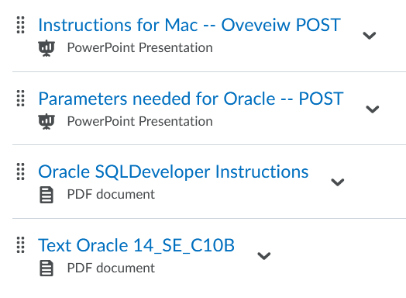
Oracle
Oracle connection parameters:
Hostname: 10.252.14.53
Port: 1521
SID: orcl1 [Note this is like “Oracle1” abbreviated.]
Username: [GIVEN OUT IN CLASS]
Password: [GIVEN OUT IN CLASS]

Slide 4
TODAY
Conceptual modeling
Review of entity-relationship model Chen Notation
Crow’s Feet Notation
Example: Highline University
Relational Model

Slide 5
Session 1 Concepts
Main constructs of conceptual model
Three examples (Walmart, COVID, Russian Soldier)
How would you compare them on their data analysis?
What dimensions would you use?
What is data-driven decision making?
Why might it be important in today’s world?
Why consider data as a corporate asset?
Types of data – internal vs external (implications?)

Slide 6
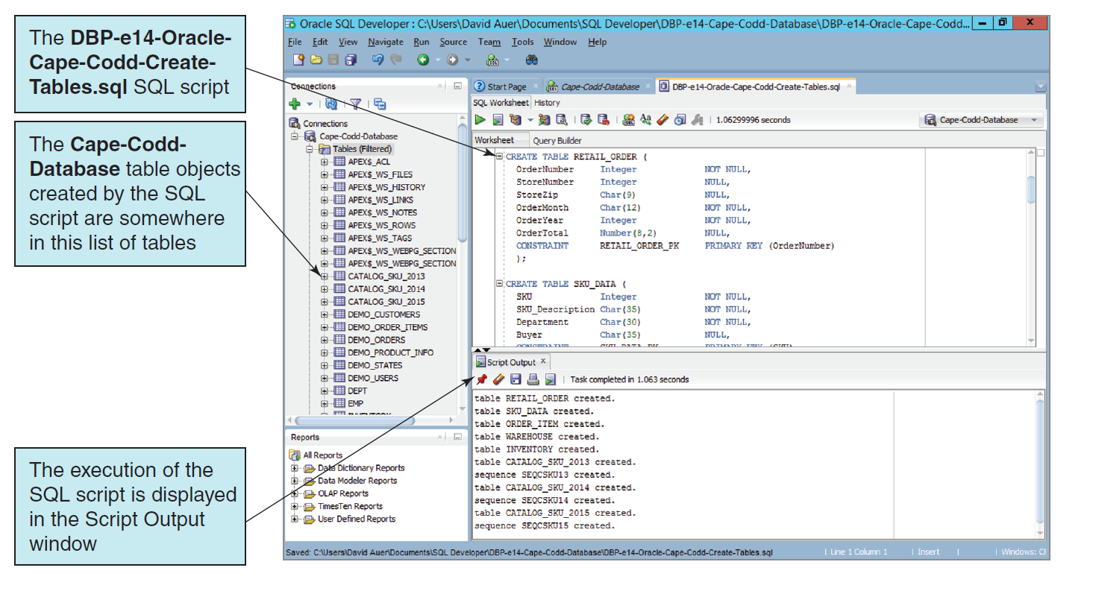

Slide 7
Questions
?

